Slide 1

Furniture sales forecasting
Presentation on - EDA & ML on Furniture Sales Forecasting
By – Mosharrat Marufa

Slide 2

Project Overview
Our project aims to perform EDA and develop a Machine Learning Model with highly accurate furniture sales forecasting.
Here we focus on –
Data Collection
Data Wrangling
Statistical Analysis
Time Series Analysis
Feature Engineering
Machine Learning Forecasting Model Development
2.
Data Wrangling
1.
Data Collection
7.
Feature Engineering
8.
Machine Learning Model
3. Statistical Analysis
4.
Perform EDA
6.
Time Series Analysis
5.
Creating New Feature

Slide 3
Objectives
Our objective is to perform exploratory data analysis with storytelling and forecasting furniture sales to optimize business strategies by analyzing -
We’ll start by collecting data, then perform data wrangling, feature engineering, analyzing SARIMAX and ARIMA model to that clean dataset, perform hyper parameter tuning and try to find out best parameters with best model. At last, we’ll train the model which is the best fit for forecasting the dataset.
Perform EDA
Feature Engineering
Resampling
Decomposition
Stationary Check
Train Test Split
SARIMAX Model Analysis
ARIMA Model Analysis

Slide 4
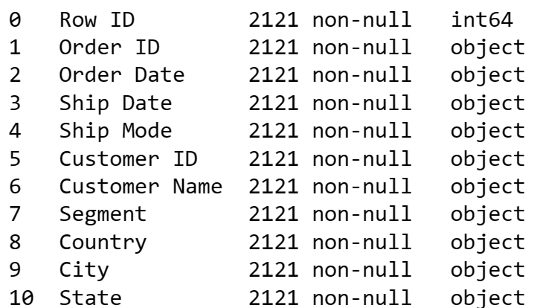
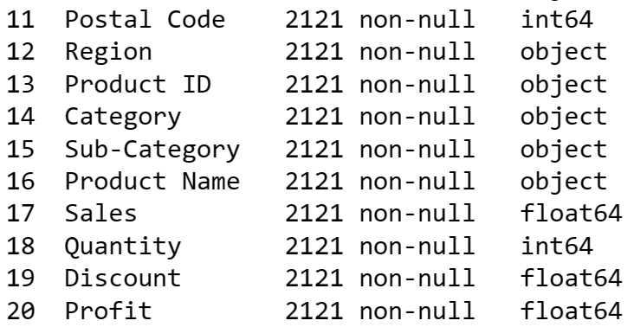
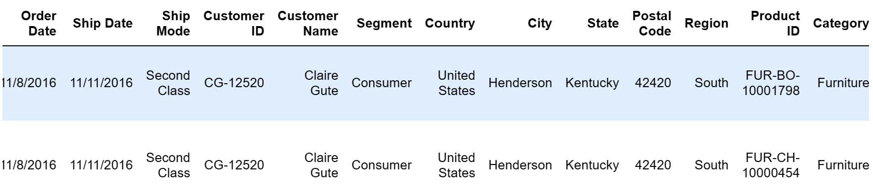
Dataset Overview

Slide 5
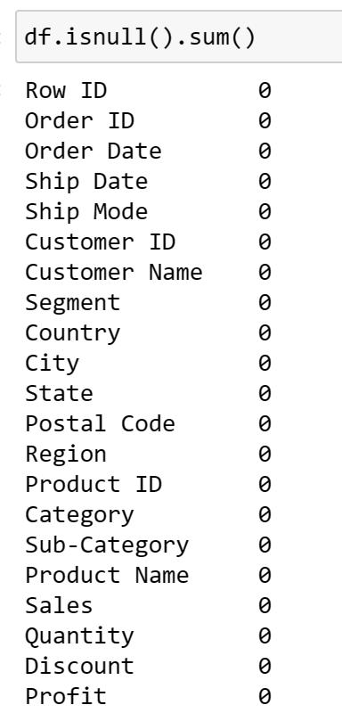
Data Wrangling – Null Detection & Correction
We’ve searched for null value through
our dataset.
No null valued column exists.

Slide 6
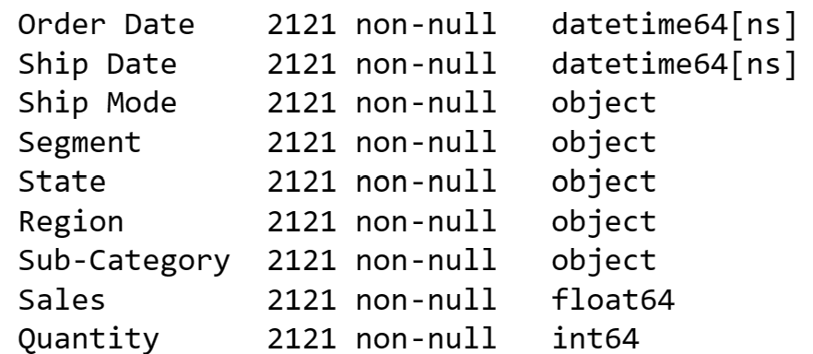
Data Wrangling – Data Type Correction
There are some anomaly datatype. We’ve checked through and corrected the datatype.

Slide 7
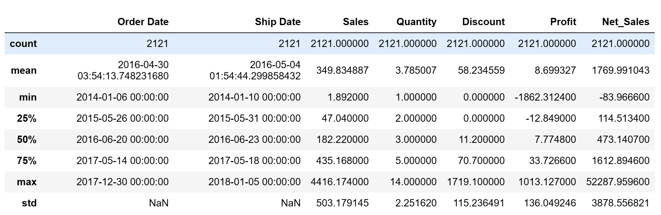
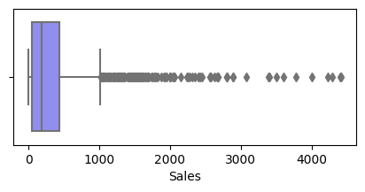
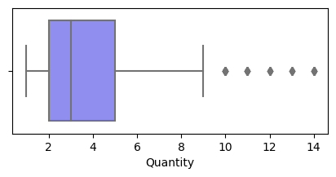
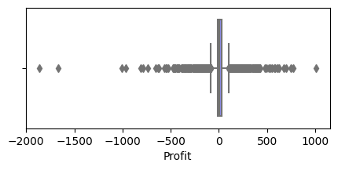
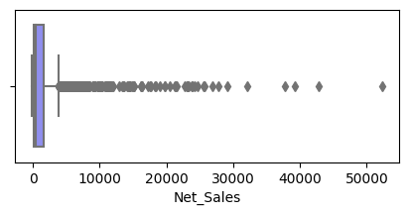
Data Wrangling – Outliers Detection & Correction
Outliers are detected in more that one columns. We’ve checked out Z-Score and keep the outlier values at most 3α .

Slide 8
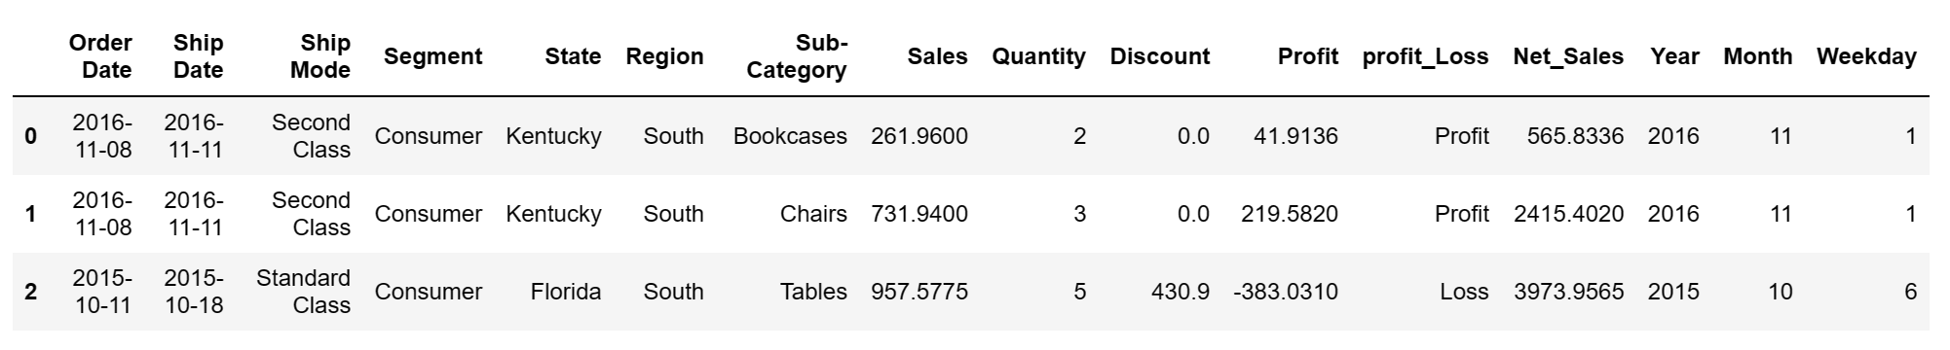
Data Wrangling – Creating New Feature
We’ve Unit-Sales, Quantity, Discount and Profit columns. We’ve used financial formula here to create ‘Net_Sales’ column. Along with that, we’ve created ‘Profit_Loss’, ‘Year’, ‘Month’, ‘Weekday’ columns also for further analysis.

Slide 9
Data Wrangling – Removing Features
There is no use of somebody’s personal information for performing EDA and Machine Learning like- 'Customer ID’, 'Customer Name’, 'Postal Code’ and etc. So, we’ve simply removed the columns.
Finally, our dataset has been like –

Slide 10
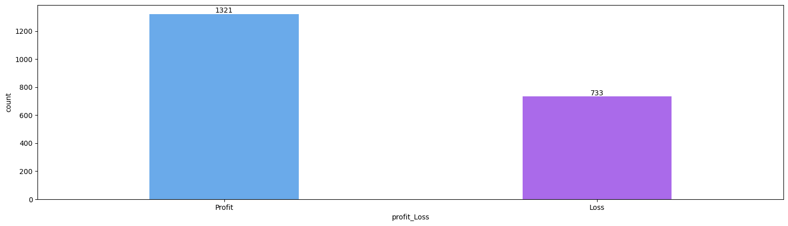
EDA- Exploratory Data Analysis
The proportion of loss is also significant we can see by this following graph.

Slide 11
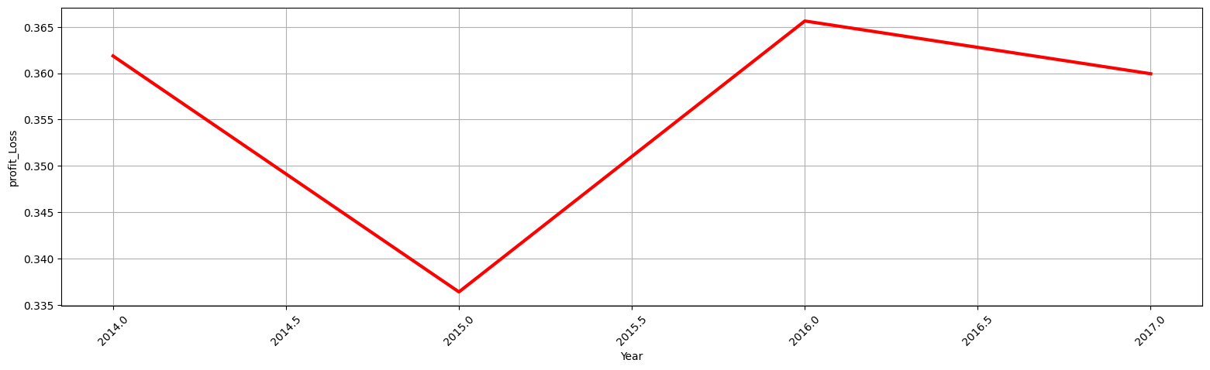
EDA- Year Analysis
We’ve found that in the year of – 2016 to 2017 there is continuously high average value of having loss.

Slide 12
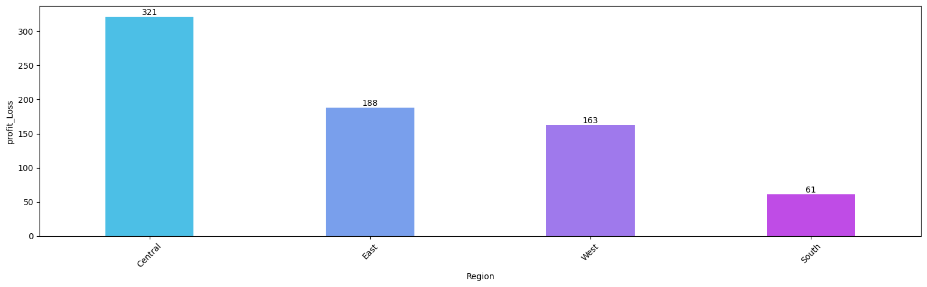
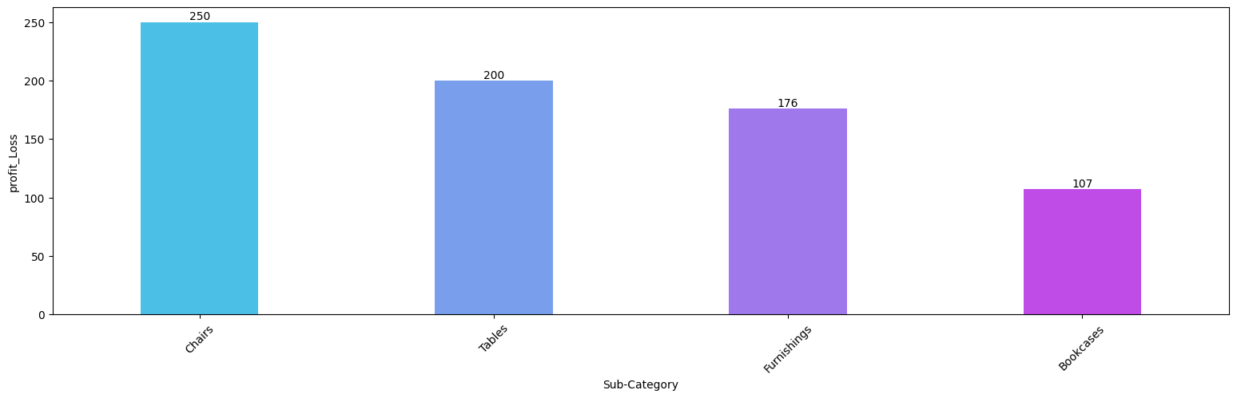
EDA- Exploratory Data Analysis
CHAIR and TABLE have been the cause of loss in CENTRAL AREA we notice in this following bar chart.

Slide 13
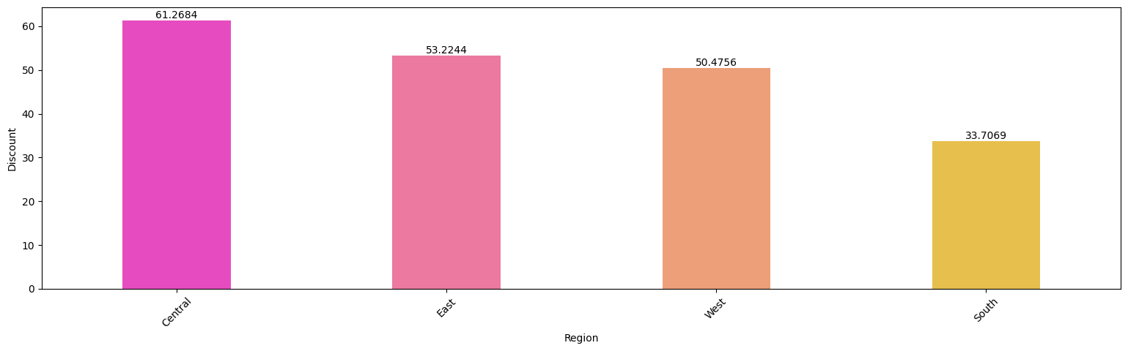
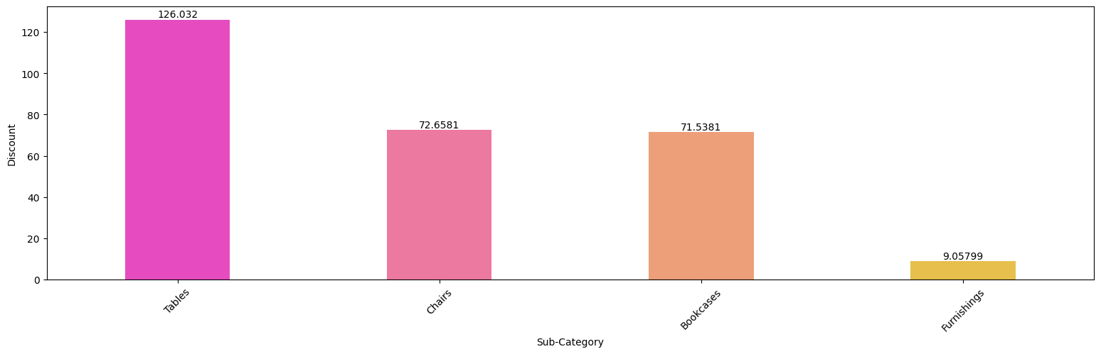
EDA- Exploratory Data Analysis
We’ve analyzed deeper why in the Central USA has this kind of high loss specifically in Chair and Tables. We’ve seen that the discount is so high in Table at Central USA area and this leads to overall loss.

Slide 14
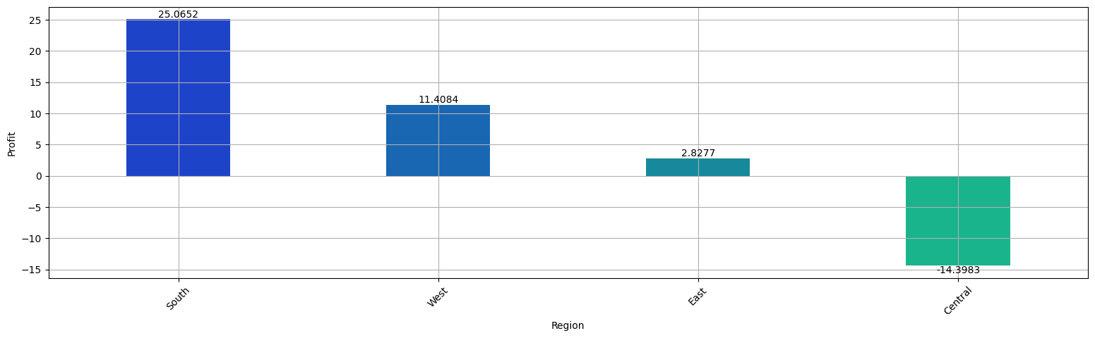
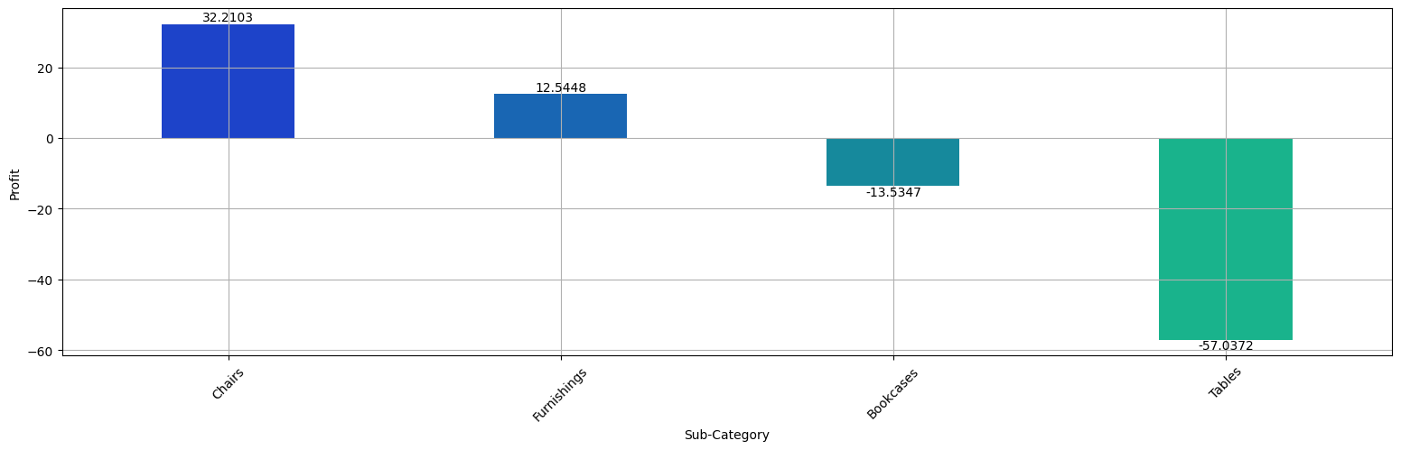
EDA- Exploratory Data Analysis
Final Analysis is in Sub-Category: TABLE in CENTRAL AREA has HIGH DISCOUNT which leads to loss. We can see the negative profit value at the rightest bar in these both graphs.

Slide 15
Data Story Telling
The proportion of loss is also significant.
We’ve found that in the year of – 2016 to 2017 there is continuously high average value of having loss.
CHAIR and TABLE have been the cause of loss in CENTRAL AREA we notice in this following bar chart.
Final Analysis is in Sub-Category: TABLE in CENTRAL AREA has HIGH DISCOUNT which leads to loss. We can see the negative profit value at the rightest bar in these both graphs.

Slide 16
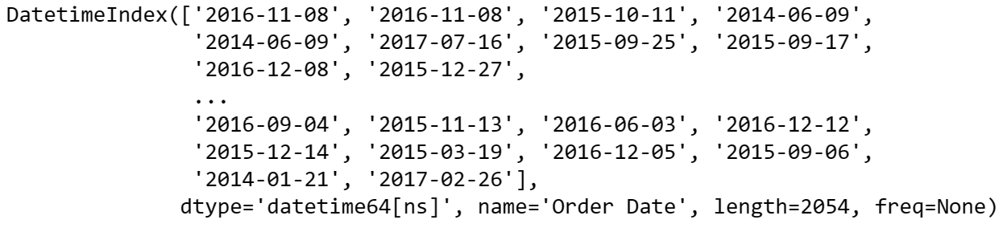
Machine Learning
Now our dataframe is ready to perform forecasting machine leaning algorithm and find out the forecasting trend.
For that, we’ve converted ‘Order Date’ to index column.

Slide 17
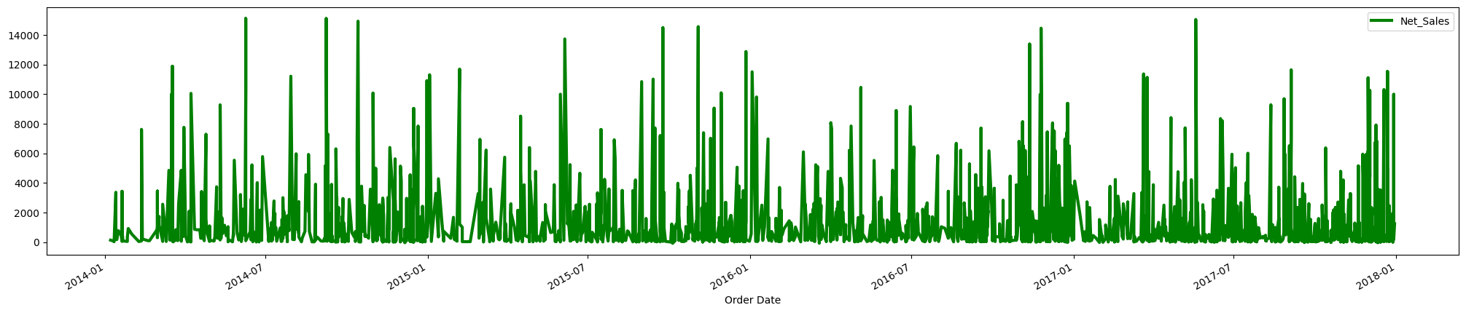
Resampling
We are trying to check seasonality of my dataset by formulating this graph. But this graph shows no understandable trend. So that we’ll perform resampling first in the next slide.

Slide 18
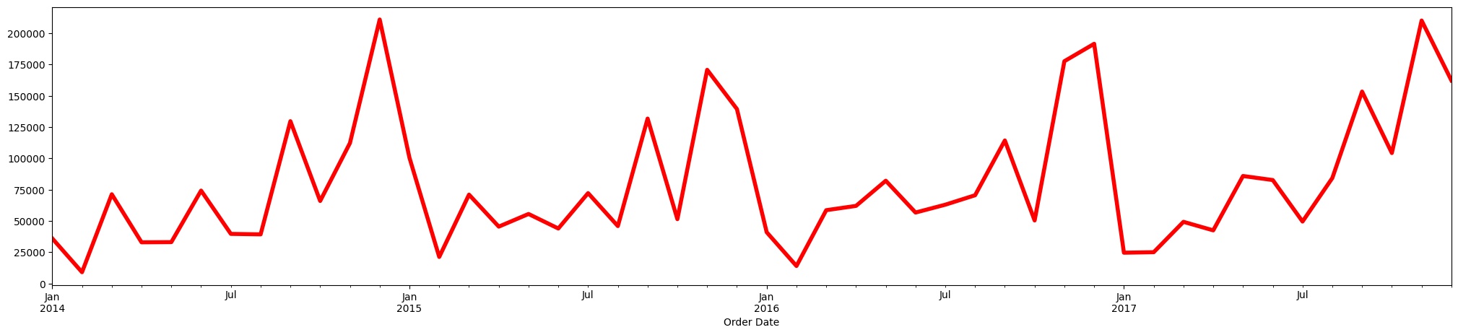
Seasonality & Stationarity Check
After resampling by ‘Month’ the dataset shows this graph. Here, we can see that, the graph looks like it is seasonal by pick point and not stationary. But for ensuring this issue we need to perform Hypothesis Test mainly: P-Value along with Dickey- Fuller test.

Slide 19
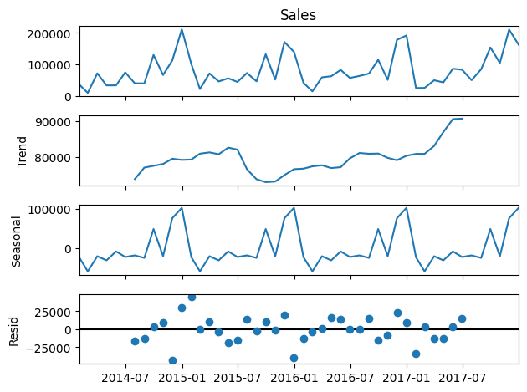
Decomposition
Here we can find out whether the data –
follows any trend or not
Residual
Seasonality

Slide 20
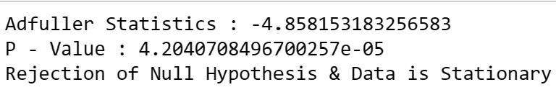
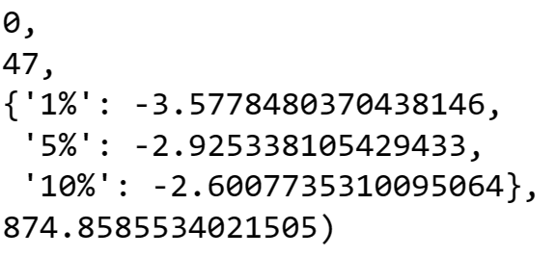
Hypothesis Testing :
Dickey-Fuller
P-Value
Using this Adfuller Statistics and P-Value we are trying to find out whether the data is stationary or not.
We can find out that the dataset is rejecting Null Hypothesis, and it is stationary data.

Slide 21
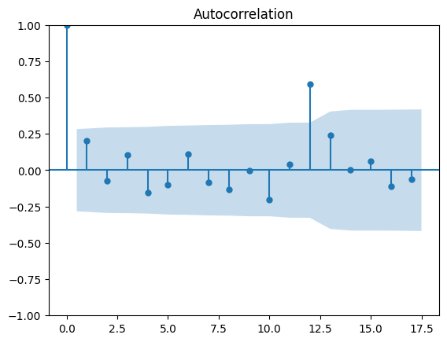
ACF – Auto Correlation Function
We use acf() function to calculate autorrelation for every lag in time series in Python.
In this acf graph drawn beside, we’ve analyzed the moving average(MA) and the q value, which is 12 significantly.
So, q=12

Slide 22
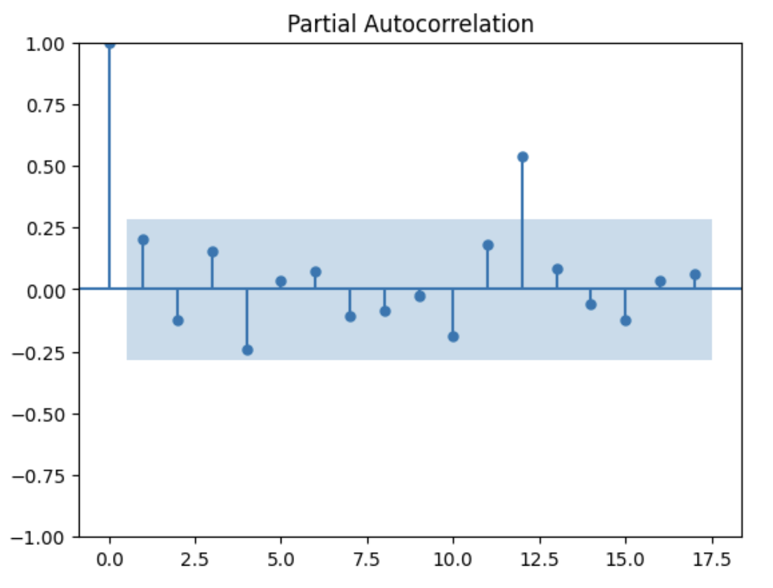
PACF – Partial Auto Correlation Function
We use pacf() function to help assess the connection between two variables by factoring in the impact of other relevant variables, providing a more nuanced understanding of their relationship.
In this pacf graph drawn beside, we’ve analyzed the autoregression(AR) and the p value, which is 12 significantly.
So p=12

Slide 23
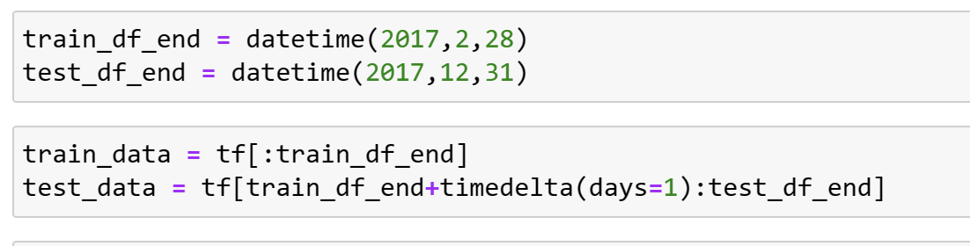
Train test split
In this stage we’ve split the data for training and testing purpose.

Slide 24
SARImax model

Slide 25
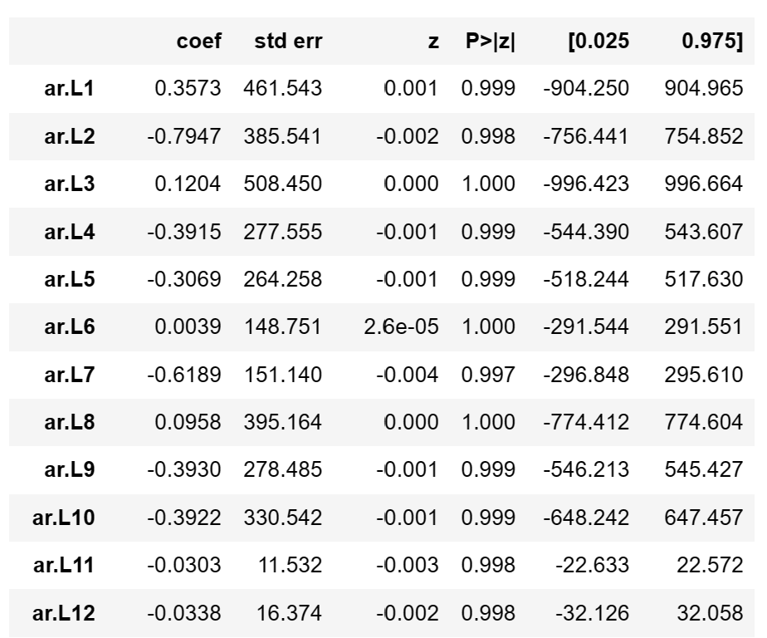
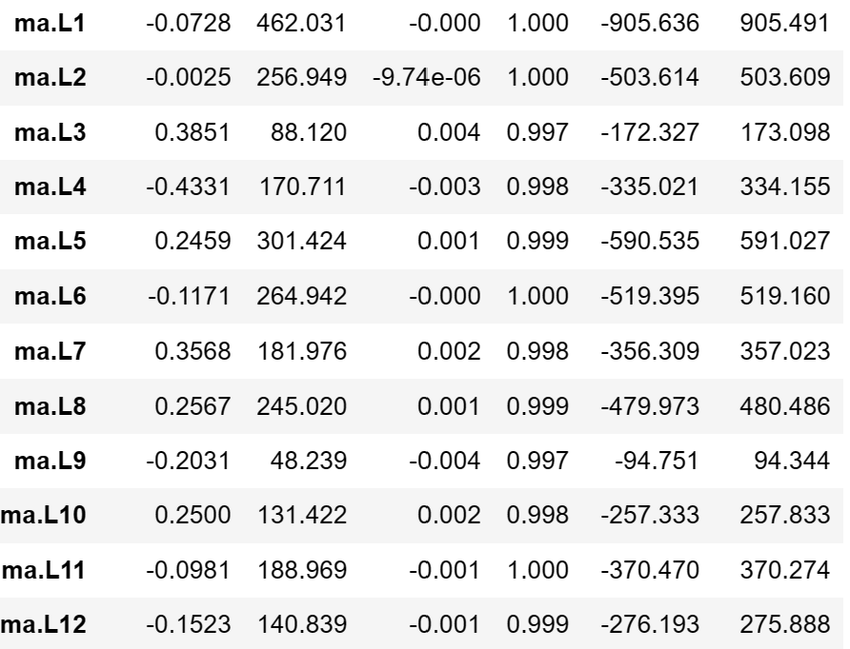
Sarimax summary
We’ve analyzed the SARIMA model’s AR in the first graph which is nothing but Autoregression.
We’ve also analyzed the SARIMA model’s MA in the second graph which Moving Average.

Slide 26
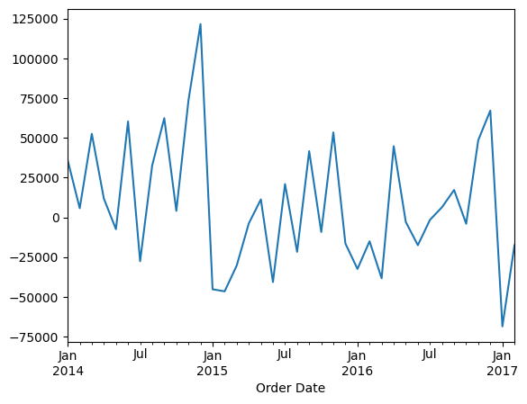
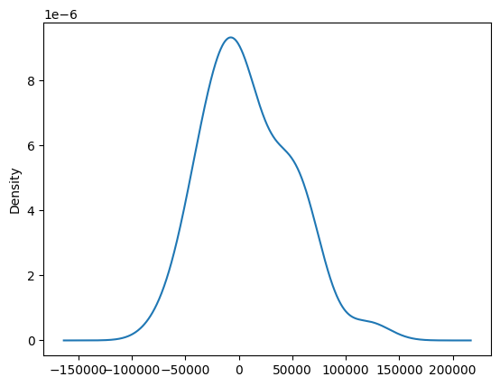
Sarimax residual
We’ve analyzed the SARIMA model’s residual in the upper graph. We can see that from jul-jan 2014 the residual is high.
We’ve analyzed the residual kde graph. We can notice that it is a bit curved in y=6. But it won’t occur any problem in model.

Slide 27
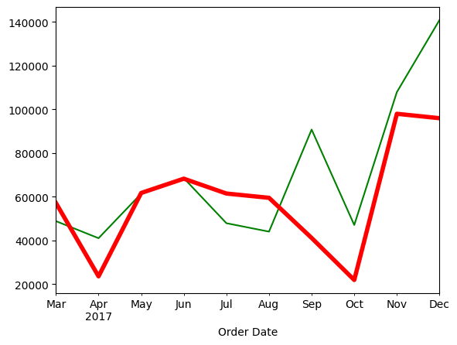
Sarimax model
Here the green line is train data and the red line is forecasting.
We can notice that it is not pretty much good model, because sometimes it over forcasting.

Slide 28
ARIma model

Slide 29
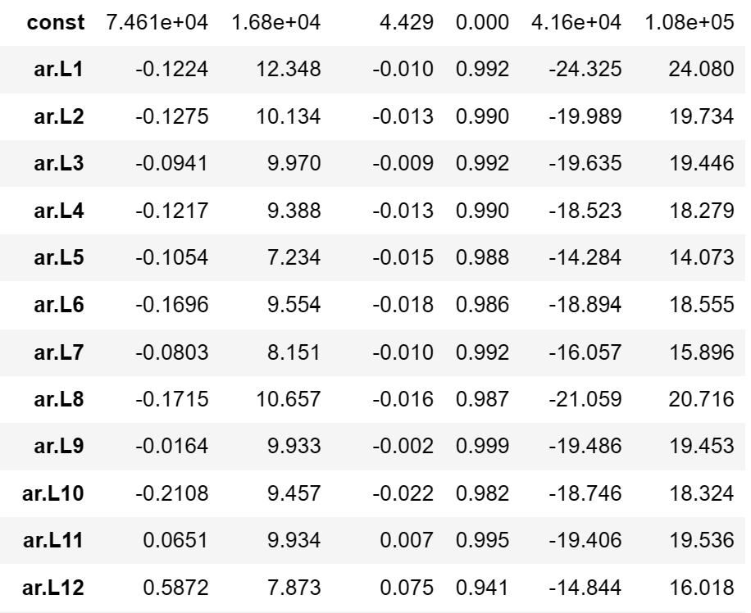
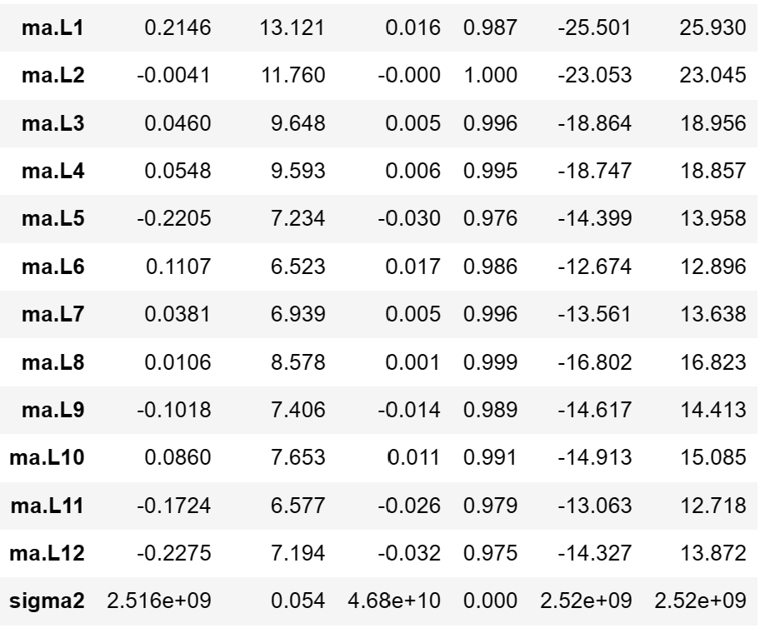
arima summary
We’ve analyzed the SARIMA model’s AR in the first graph which is nothing but Autoregression.
We’ve also analyzed the SARIMA model’s MA in the second graph which Moving Average.

Slide 30
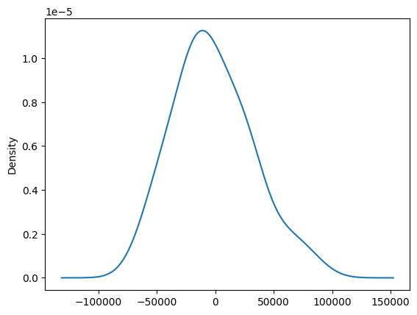
arima residual
We’ve analyzed the residual kde graph. We can notice that there is no curve in the graph. It’s a smooth kde.

Slide 31
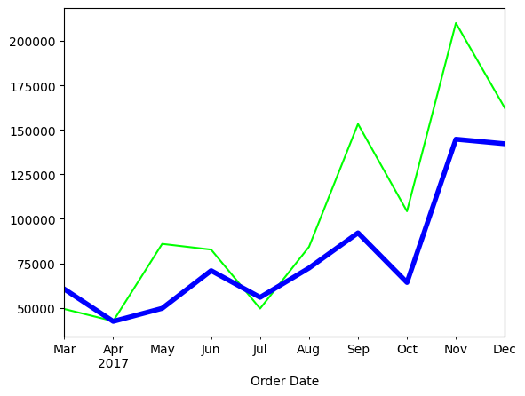
arima model
Here the green line is train data and the blue line is forecasting.
We can notice that it is pretty much good forecasting model rather than SARIMAX.
So, we’ll fit this model for further forecasting trend.

Slide 32
Thank You
Presentation on EDA & ML on Furniture Sales Forecasting
By – Mosharrat Marufa

